Slide 1
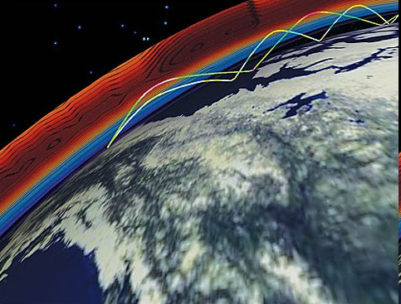
HF Propagation
How to snag that DX!
Michael Smith, N5TGL

Slide 2
Agenda
Purpose
Three Magic words
Understanding Propagation
Propagation modes
How solar activity impacts the ionosphere
Learning the numbers
A and K index, SFI, 304A, etc : Understand what those numbers mean
Understand how to use those numbers to your advantage
Ionosondes – a secret weapon!
What are they?
What data do they provide?
How do I read them?
How do I use that data?
What’s all this X and O mode stuff?
Propagation prediction

Slide 3
Purpose
Understand more about the ionosphere
Learn how the sun impacts propagation
Understand the metrics that help predict propagation conditions
Discover where to find those metrics
Use that information to your advantage

Slide 4
Three Magic Words Courtesy of Eric Nichols, KL7AJ
True progress in science (or any other field) begins with three magic words – I was wrong.
There is an amazing liberating effect when you utter these words. It opens up your mind to endless possibilities.
The ionosphere is a spherical shell. I was wrong.
The ionosphere is smooth. I was wrong.
The ionosphere is reciprocal. I was wrong.

Slide 5
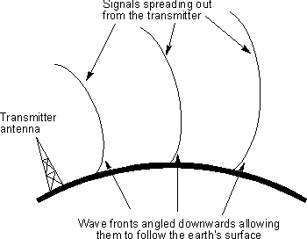
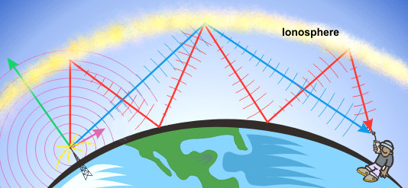
Propagation Modes
Ground wave
Doesn’t start happening until 80m
More likely on 160m
Will happen on 600m
Direct
Think line-of-sight
Skywave
This is ionospheric propagation

Slide 6
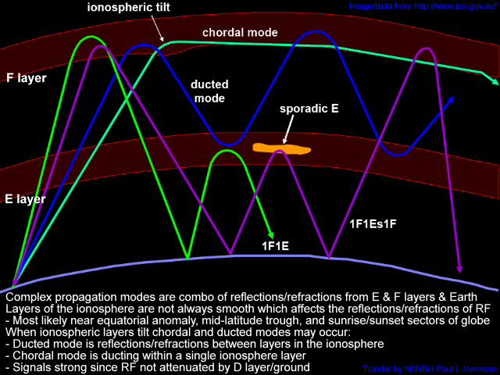
Propagation Modes

Slide 7
Solar Flux And Sunspots
The K index is computed once every three hours (eight times a day) and the values can range from 0 to 9, with 0 being inactive, and 9 representing an extreme severe storm condition
The A index is linear, and is computed from the eight previous K index values. It ranges from 0 (quiet) to 400 (severe storm).
A = 0 - 7 Quiet
A = 8 - 15 Unsettled
A= 8 - 15 Unsettled
A = 16 - 29 Active
A = 30 - 49 Minor storm
A = 50 - 99 Major storm
A = 100 - 400 Severe storm
K = 0 Inactive
K = 1 Very quiet
K = 2 Quiet
K = 3 Unsettled
K = 4 Active
K = 5 Minor storm
K = 6 Major storm
K = 7 Severe storm
K = 8 Very severe storm
K = 9 Extremely severe storm
Generally, propagation conditions are best when the A index is 15 or lower, and the K index is 3 or lower.

Slide 8
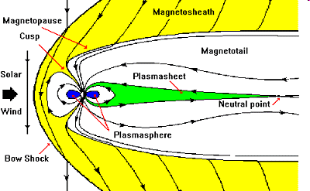
Solar storms and why we care
The earth’s magnetic field forms a bubble around our planet called the magnetosphere, which deflects solar wind gusts. Earth's magnetic field and the Interplanetary Magnetic Field (IMF) come into contact at the magnetopause: a place where the magnetosphere meets the solar wind. Earth's magnetic field points north at the magnetopause. If the IMF points south -- a condition scientists call "southward Bz" -- then the IMF can partially cancel Earth's magnetic field at the point of contact.
When Bz is south, that is, opposite Earth's magnetic field, the two fields link up. You can then follow a field line from Earth directly into the solar wind -- or from the solar wind to Earth. South-pointing Bz's open a door through which energy from the solar wind can reach Earth's atmosphere

Slide 9
Ionosondes: your window to the ionosphere
An ionospheric sounder uses basic radar techniques to detect the electron density of the ionosphere as a function of height. Each component of solar emissions tends to be deposited at a particular altitude or range of altitudes. The peaks of these layers usually form between 70 and 300 km altitude and are identified by the letters D, E, F1 and F2, in order of their altitude.
By scanning the transmitted frequency from 1 MHz to as high as 40 MHz and measuring the time delay of any echoes, a vertically transmitting sounder can provide a profile of electron density vs. height.

Slide 10
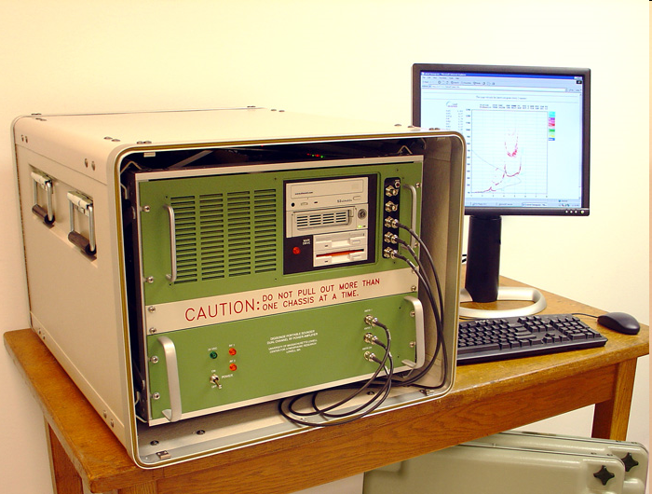
Ionosonde

Slide 11
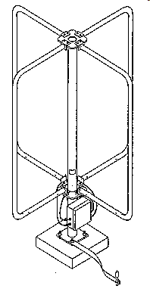
Ionosonde antenna

Slide 12
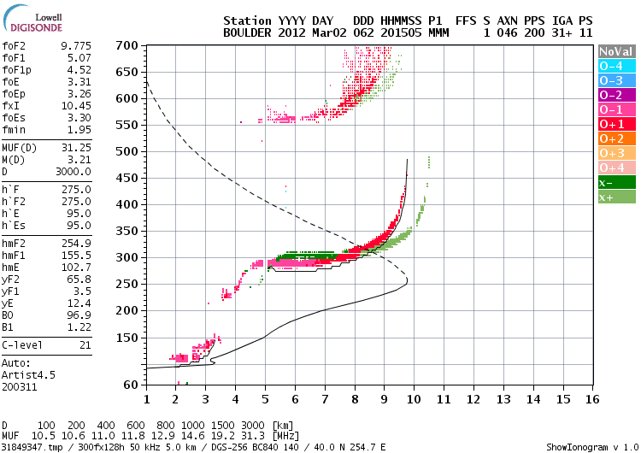
Ionogram
3:15 pm

Slide 13
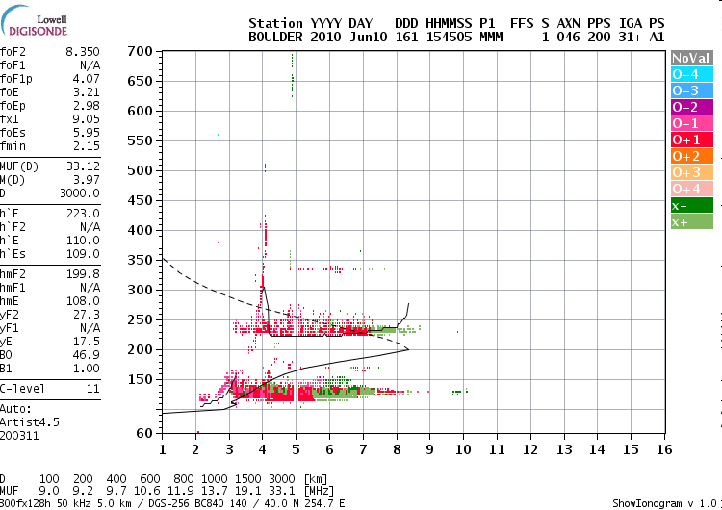
What does Es look like?

Slide 14
Food for thought: X and O Mode Propagation from Eric Nichols, KL7AJ
For about a century there has been a conspiracy of silence in amateur circles about a couple of things known as X-mode and O-mode propagation. This is really surprising since X-mode and O-mode propagation modes have been known about for at least sixty years, and are fully acknowledged by just about every communications professional.
If you transmit a radio signal through the ionosphere, unless you happen to be at precisely the magnetic equator, your radio signal splits into two signals. One of these signals will be clockwise circular polarized.
This is known as O-mode (for ORDINARY mode, in the northern hemisphere). The other signal will be counterclockwise circular polarized. This is known as the X-mode signal (for eXTRAORDINARY mode, in the northern hemisphere.
At any rate, even if your transmitted signal is perfectly linear, such as generated by a simple dipole, by the time the signal gets up to the ionosphere and back down again, you have two signals, one spinning clockwise and one spinning counterclockwise. Now the plasma physics that creates this phenomenon is quite fascinating, but well beyond the scope of this presentation. The thing you need to know is that you will ALWAYS have an X-mode and an O-mode signal when you transmit through the ionosphere. This is so easy to prove with simple circularly polarized antennas that nobody has ever bothered to dispute it. But, true to form, most hams generally just ignore the whole topic and chalk up weird propagation to "black magic."

Slide 15
Food for thought: X and O Mode Propagation from Eric Nichols, KL7AJ
The fact of the matter is that a good deal of the "weirdness" of H.F. radio propagation can be explained by exploring the X and O properties of the signals. Probably 99.9% of all radio amateurs are clueless about this very fundamental property of the ionosphere. You can't blame the hams though, because it's totally absent in the amateur literature as well.
The correct thing to do is to TAKE ADVANTAGE OF THESE DIFFERENT MODES! The X-mode and O-mode signals not only have two different paths in the azimuth, but also have different critical heights. This is the sort of thing that ordinary hams can experiment with and actually make a contribution to the technology and science.
Take a look at a typical ionogram. Notice the well defined red and green traces? The red trace is your O-mode signal, and the green trace is your X mode signal. These are real time signals. The only difference is the polarization of the receive antenna. See how the green trace has a higher critical frequency AND critical height?

Slide 16
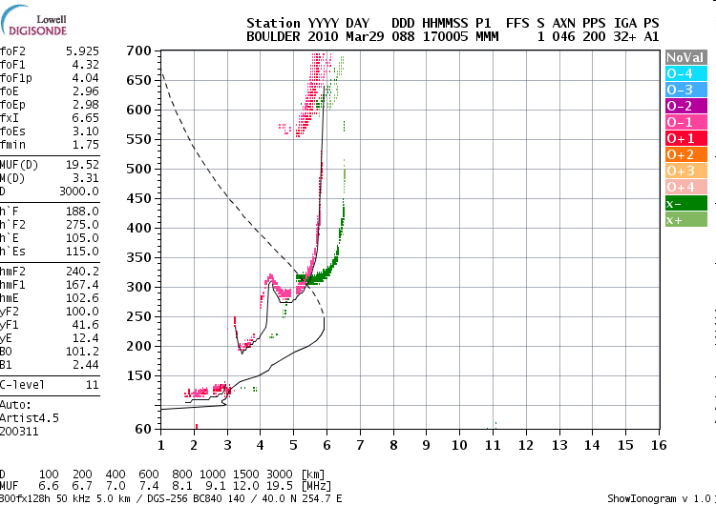
X and O Mode

Slide 17
Handy websites
http://www.spaceweather.com/ Good for current goings on in space, scope goes beyond just the sun
http://www.solarham.com/ Run by a ham up in Canada. Very good collection of solar related imagery
http://www.solarmonitor.org/ Fantastic images here, including those from the newly launched SDO. Be sure to check the “solarsoft” link for some amazing pics.
http://www.hamqsl.com/solar.html Another site run by a ham. Tons of propagation info here.
http://ulcar.uml.edu/DIDBase/ site for all of the ionosondes
http://pskreporter.info/pskmap.html Realtime captures of digital data on the ham bands

Slide 18
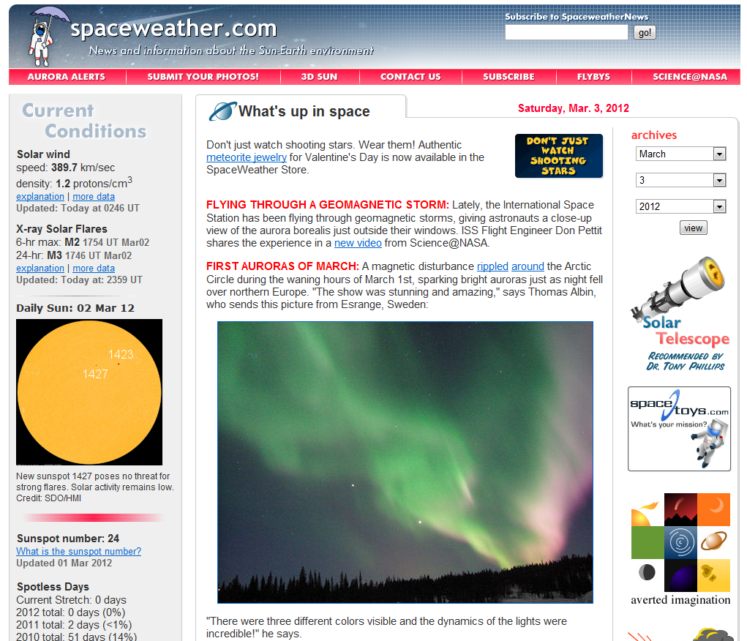
Spaceweather.com

Slide 19
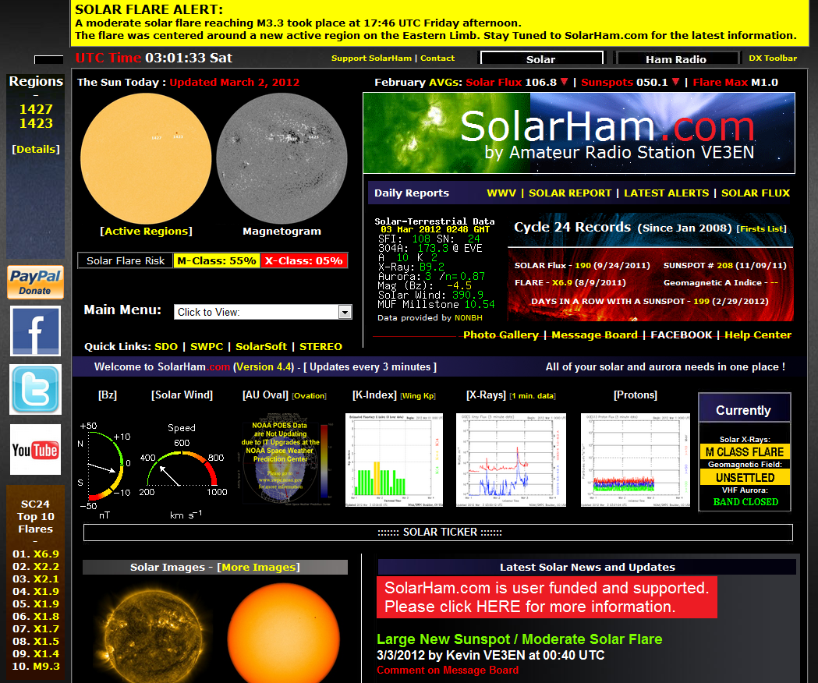
Solarham.com

Slide 20
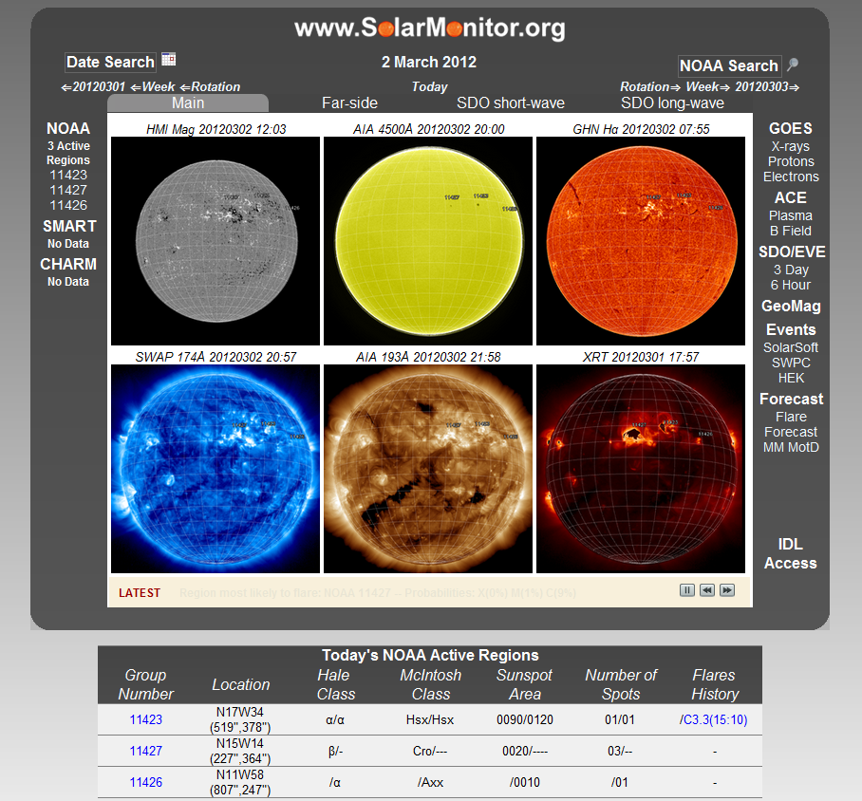
Solarmonitor.org

Slide 21
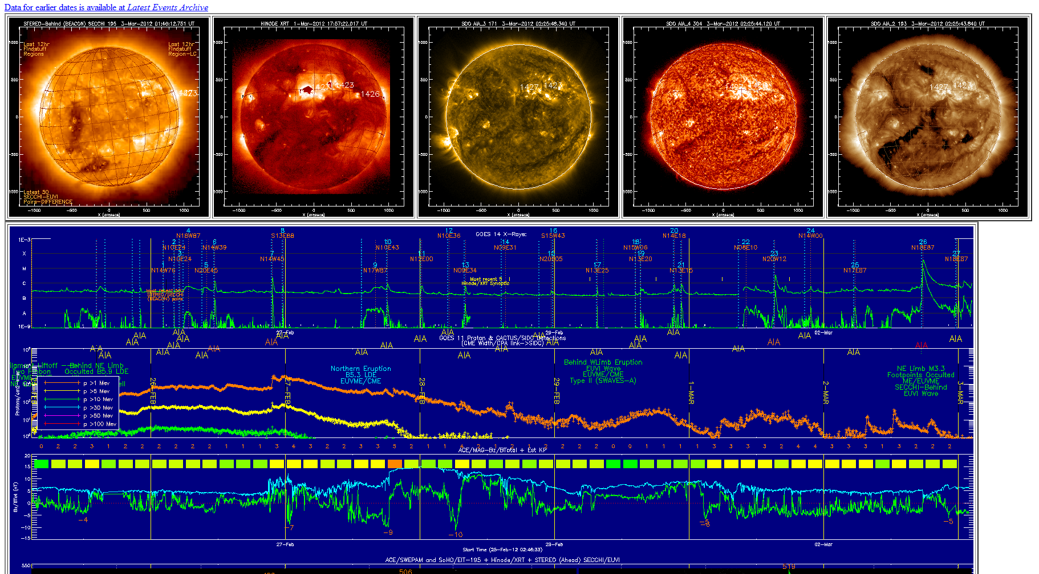
Solarsoft on Solarmonitor

Slide 22
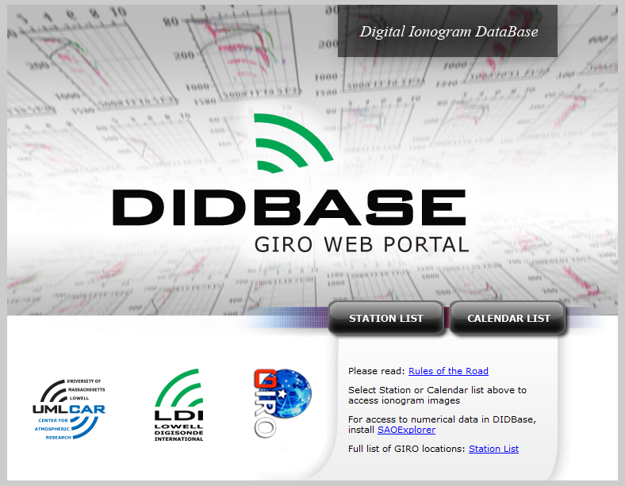
Ionogram database

Slide 23
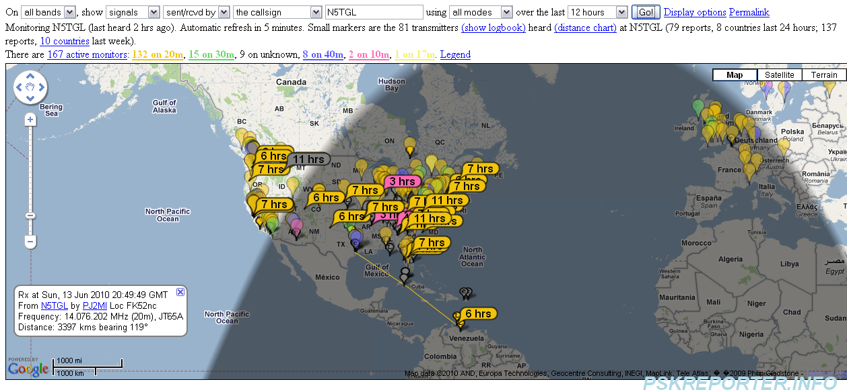
PSK Reporter

Slide 24
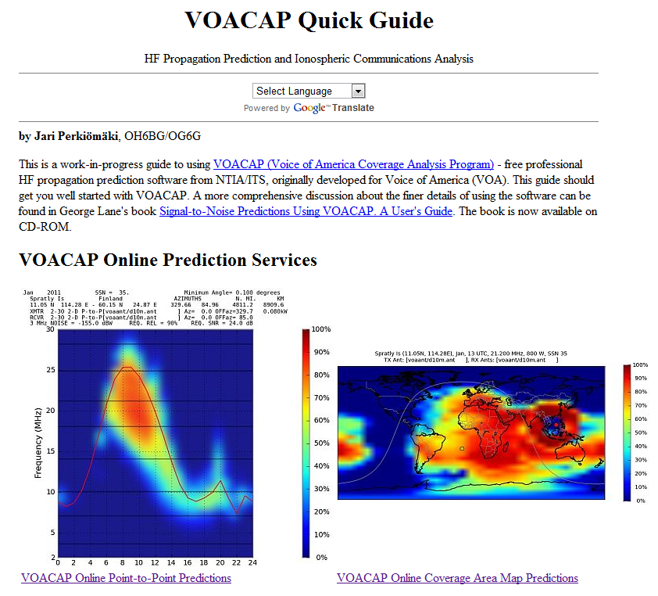
voacap.com

Slide 25
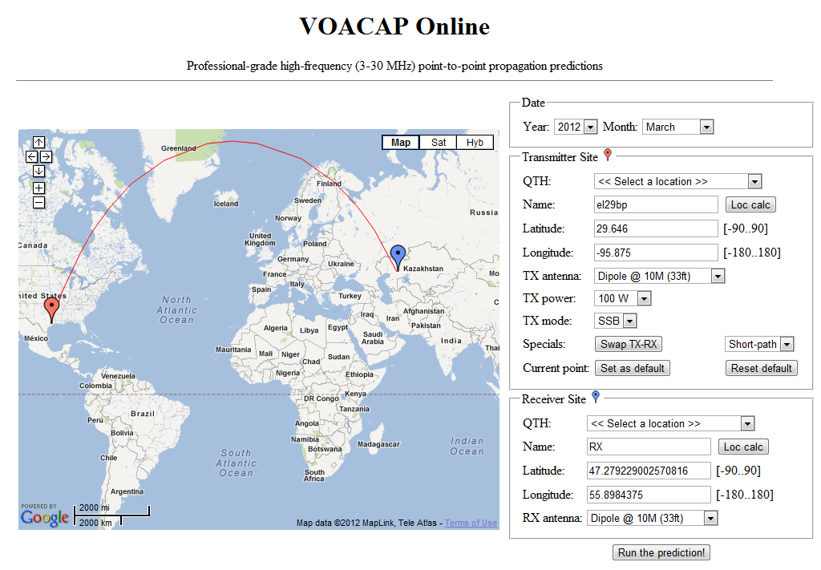
voacap.com

Slide 26
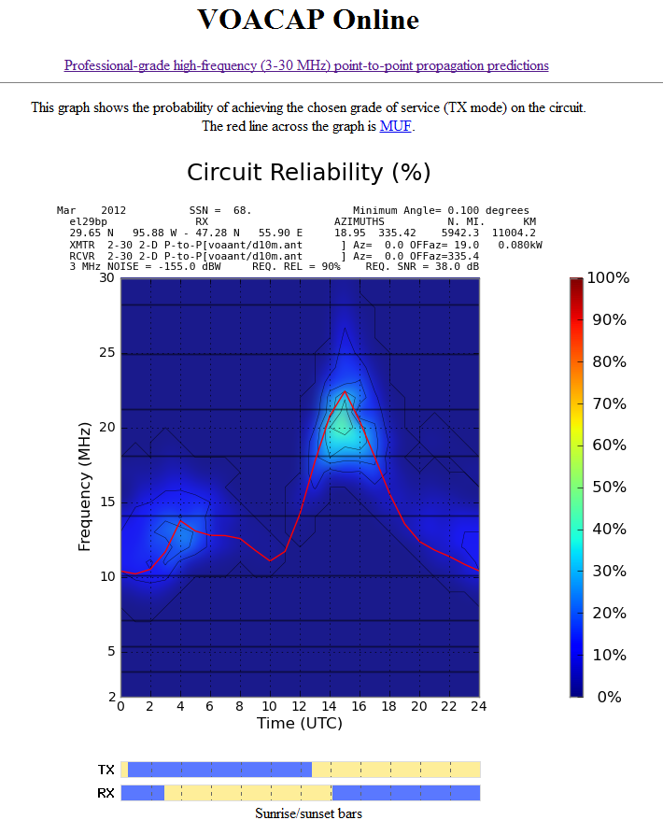
voacap.com

Slide 27
Questions?

