Slide 1
Ham and Pi
Jeff, W5JEF

Slide 2
Please allow me to introduce myself…
Jeff Greer
W5JEF
Corresponding Secretary, BVARC
IT Manager, Star Pipe Products
Serial Hobbyist
Computer Geek
Musician/Songwriter
Beer homebrewer, winemaker
Sausagemaker
Hunter
Kayak Fisherman
Cheesemaker
Ham!
Drone Pilot

Slide 3
What is Raspberry Pi?
It’s a computer.
Small
Inexpensive
Powerful?
Powerful enough, because
LINUX

Slide 4
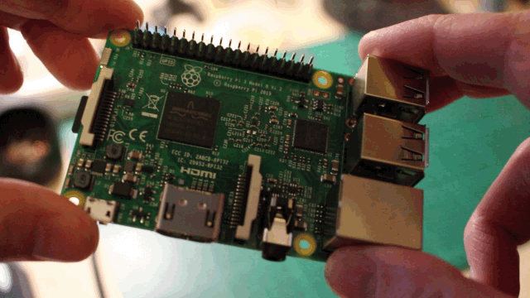
You can look. And touch.

Slide 5
Raspberry Pi History
2006 – Raspberry Pi Foundation trustee Eben Upton assembled a group of teachers, academics, and computer enthusiasts to devise a computer to inspire children
2013 – Raspberry Pi 1 A released
2014 – Raspberry Pi 1 A+ and 1 B+ released
2015 – Raspberry Pi 2 B and Zero released
2016 – Raspberry Pi 3 B released
2017 – Raspberry Pi Zero W/WH released
2018 – Raspberry Pi 3 A+/B+ released
2019 – Raspberry Pi 4 B (1GB/2GB/4GB) released

Slide 6
Raspian and NOOBS
Ewww! Linux?
MacOS is Linux
Android is Linux
…Linux is your friend.
NOOBS is Raspbian with common applications pre-installed
Raspbian is Debian that runs on ARM processors
Debian is awesome (Deb & Ian wrote it)
Debian is also the basis for Ubuntu, one of the most popular Linux distros on the planet

Slide 7
There is a version of Windows 10 that will work on a Raspberry Pi.

Slide 8
Installing Software
Raspian has a built-in app store, called apt. (Advanced Package Tool)
Examples of commands:
sudo apt-get update
sudo apt-get upgrade
sudo apt-get update && apt-get upgrade –y
apt-cache pkgnames fldigi
apt-cache pkgnames fl
apt-cache search ham
sudo apt-get install fldigi
sudo su (makes you “root” (admin) until you type “exit”)
nano is the (well, one of the) Notepad (text editor) of Linux
Don’t fear the command line; it’s not that hard

Slide 9
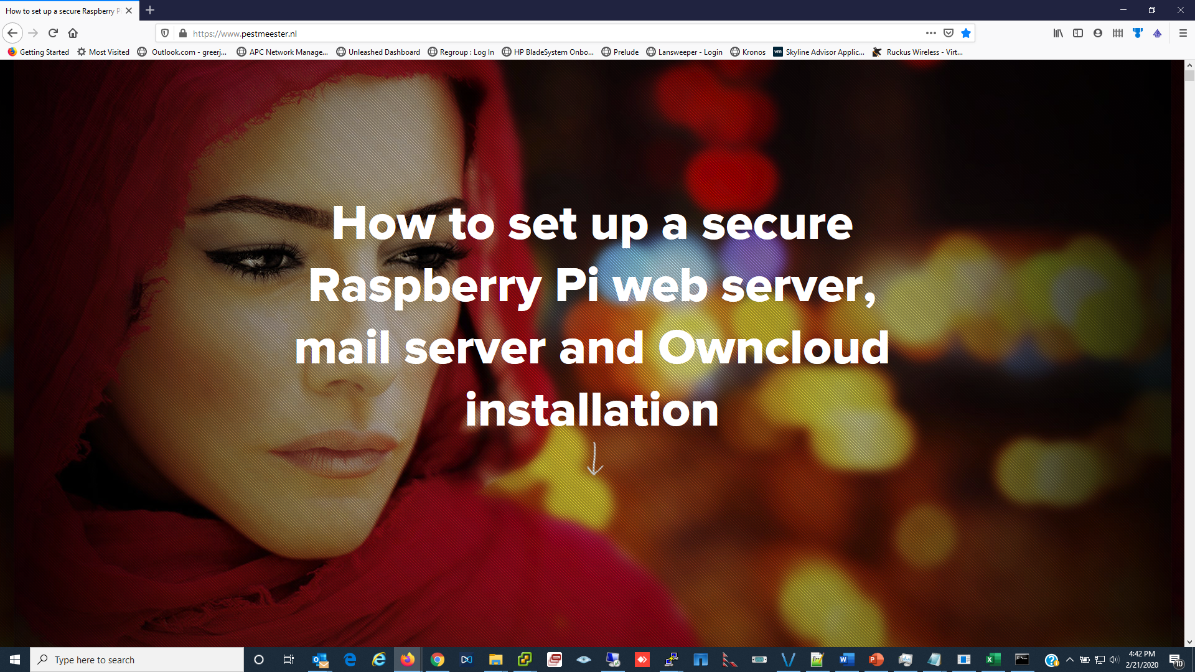

Slide 10
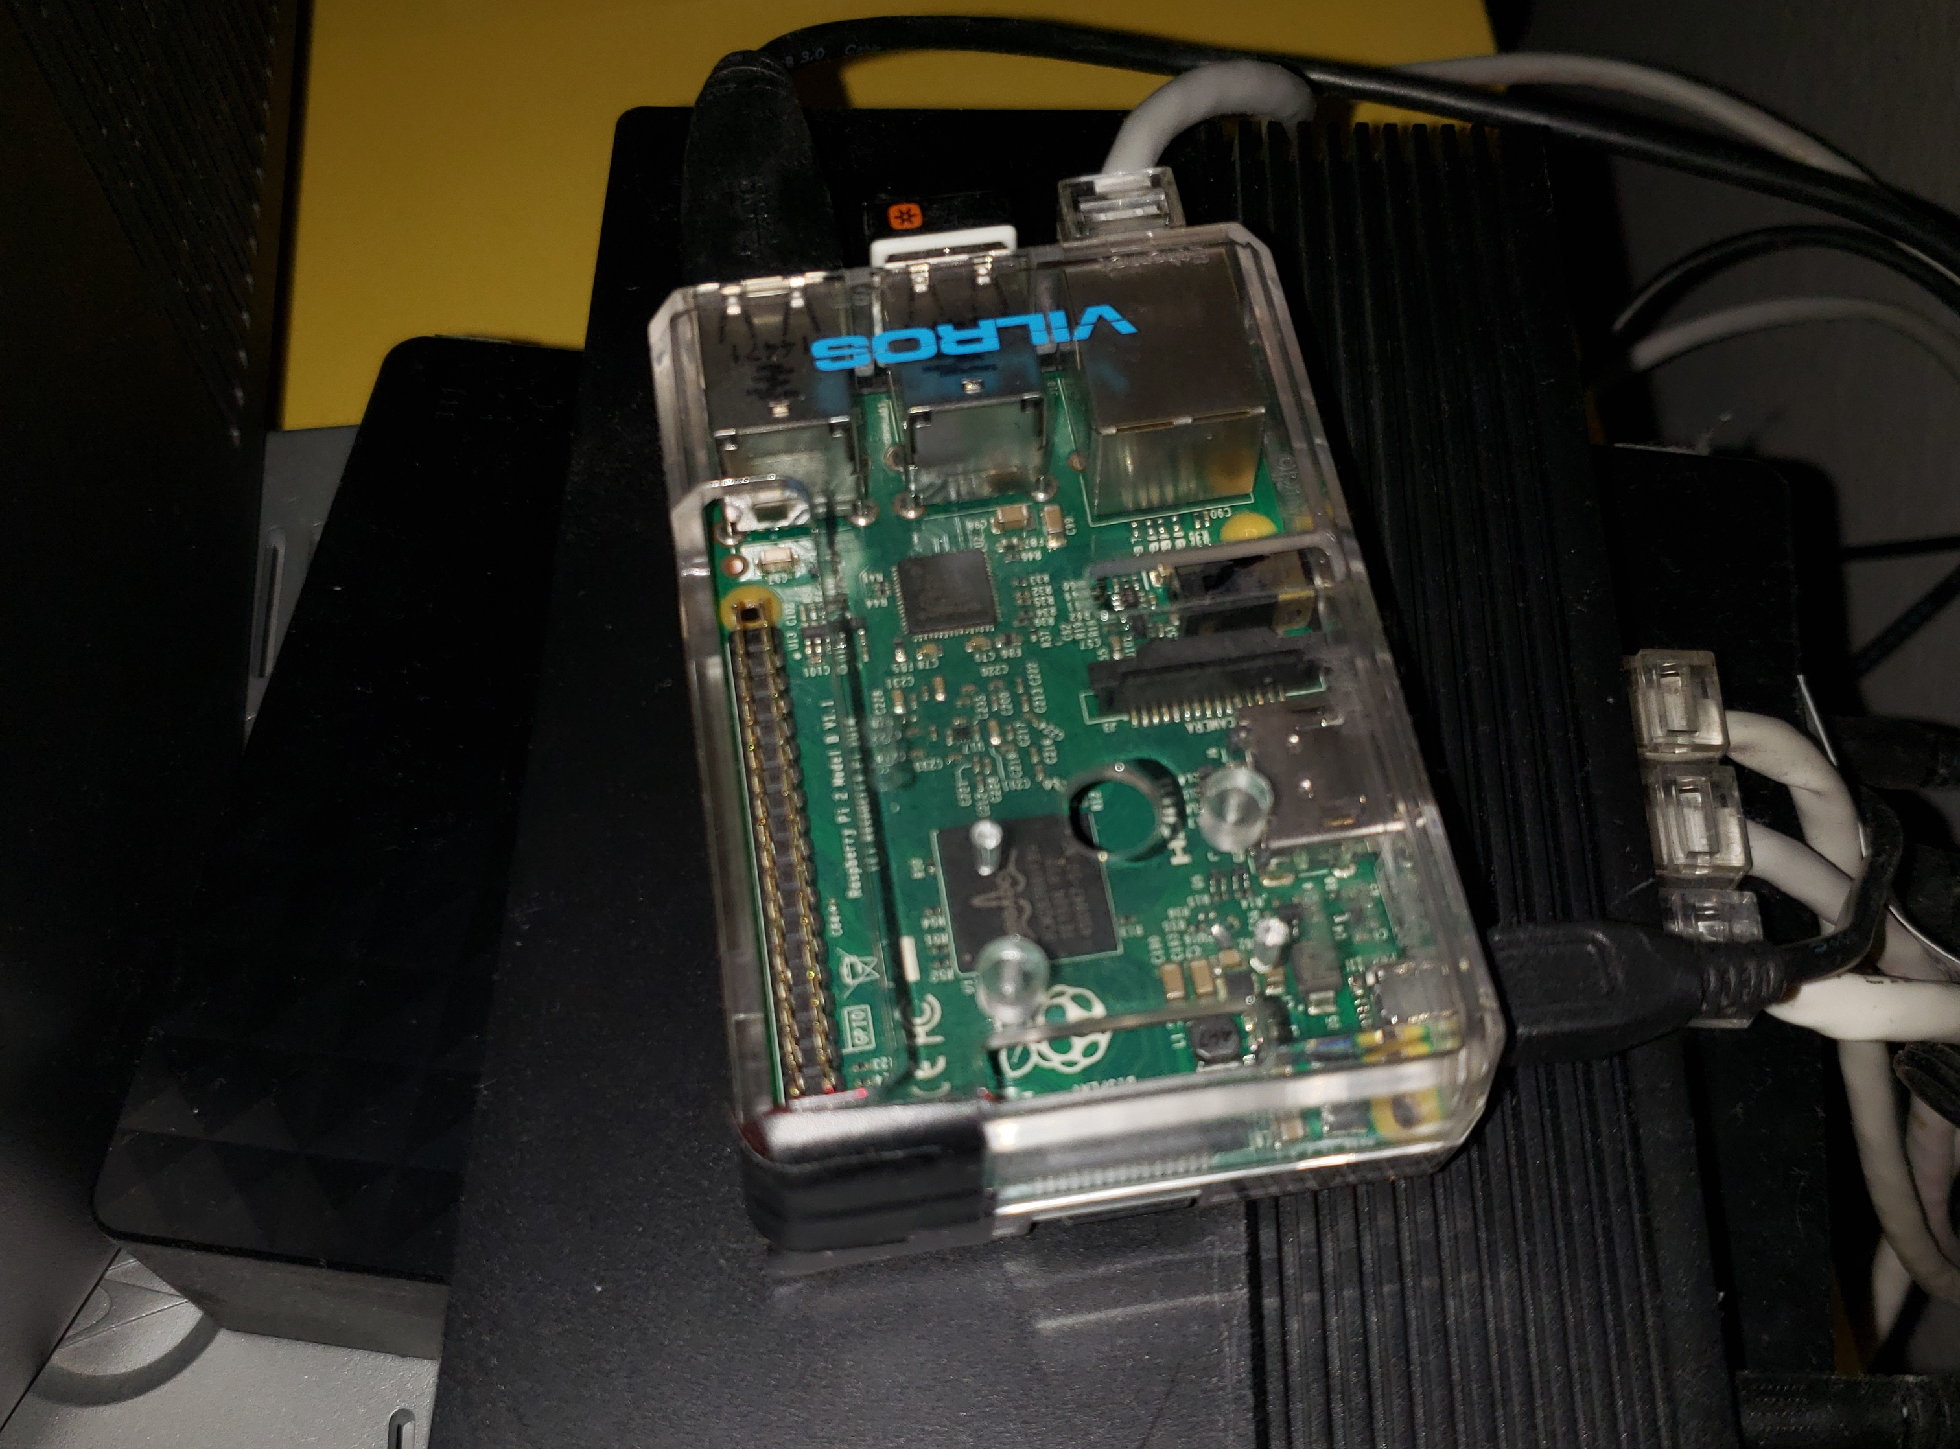

Slide 12
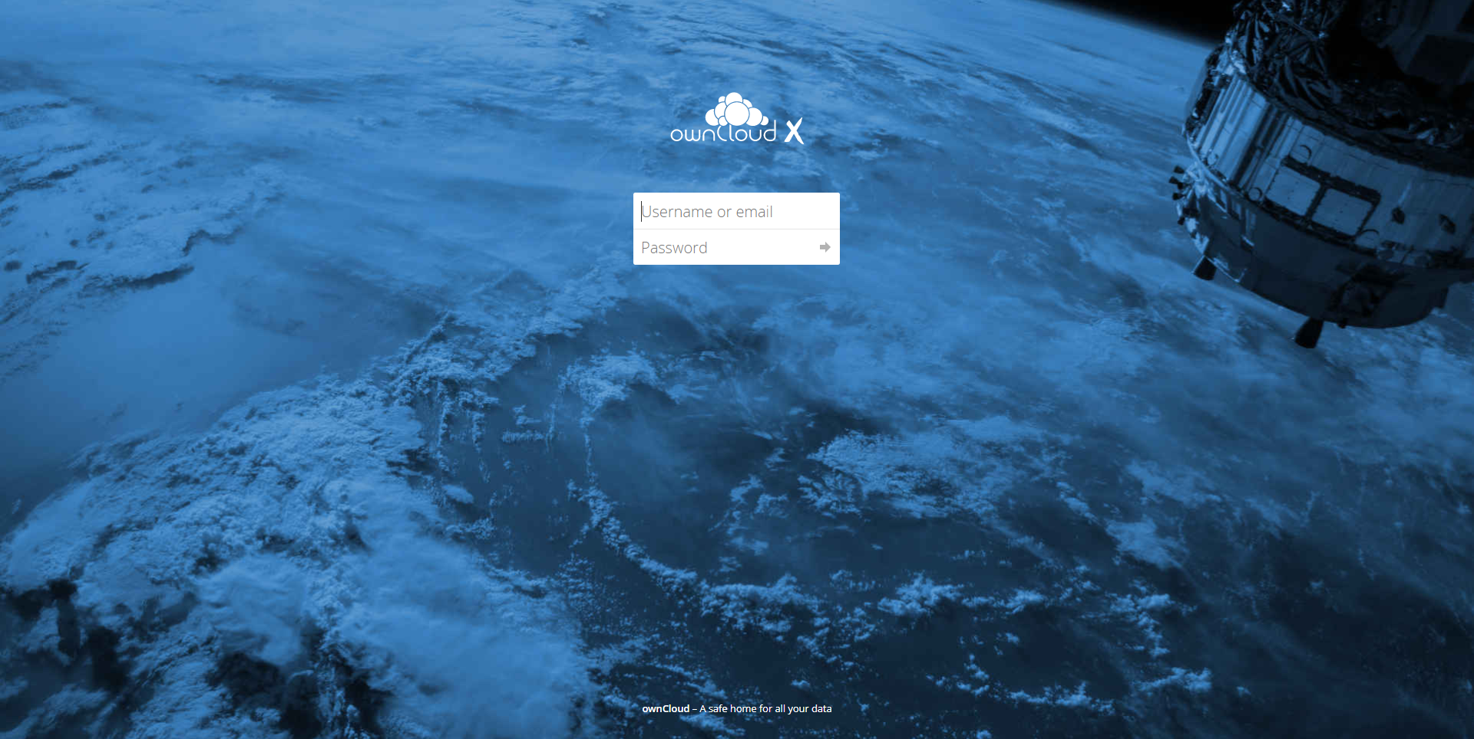

Slide 14
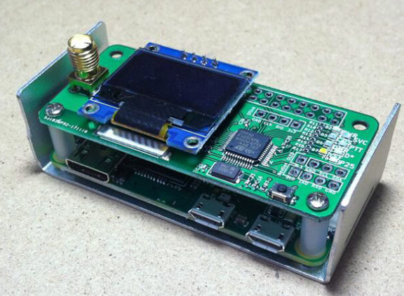
DMR Jumbospot

Slide 16
Is there software?

Slide 18
Dave Slotter, W3DJS HamPi Image
Fellow Hams and Raspberry Pi Enthusiasts,
I am pleased to announce the release of version 2 of the Raspberry Pi Ham Radio Image I've been working on. It contains extensive amount of pre-compiled, pre-installed ham radio software. (See below for an extensive program listing.)
The image will require a 32GB or larger SD or micro SD card to install. This image uses the default password for "pi" which is "raspberry". Please change it upon first launch, as the SSH server is enabled and this would be a security risk.
One more caveat: This image comes pre-installed to operate as a wireless Hotspot for field operations. If you are using this at home, and don't want to operate as a Hotspot, then open a Terminal on the Pi and type in "KillHotspot" (without the quotes) and hit return. Networking will then operate normally.
If there is too much pushback on this point, I may remove the auto-hotspot capability in a future release of the image.
I have confirmed this image starts up successfully on the Raspberry Pi Model 2 B and Model 4 B. However, some of the applications require more CPU power than the Model 2 or 3 can provide, so YMMV.
You can download it from: either http://bit.ly/W3DJSRasPiv2img or
http://bit.ly/32Xpi74 . Thanks to fellow Hams Dave Bruse and Norm Schklar for hosting the image on their servers.
This is QSL-Ware. If you download and use it, I request you send me a QSL card. (My QRZ page has my current mailing address.)
Please send me any comments or concerns here so everyone can benefit from the questions and answers.
-Dave Slotter, W3DJS

Slide 19
General Ham Radio Applications
HamLib - Ham Radio Control Libraries
grig - graphical user interface to the Ham Radio Control Libraries
CHIRP - Radio Programming Software
APRS Message App for JS8Call - GUI to send APRS messages via JS8Call
QTel - EchoLink client
QSSTV - Slow Scan TV (e.g. "Fax")
Gpredict - Satellite prediction
FreeDV - Free digital voice vocoder
BlueDV - Client for D-Star and DMR
WsprryPi - WSPR software
ADS-B Flight Tracking Software

Slide 20
General Ham Radio Applications (cont’d)
Pi3/4 Stats Monitor - by W1HKJ
VOACAP - HF propagation prediction
GPS Support
Auto WiFi Hotspot - Automatically turn your Pi into a WiFi hotspot when in the field!
wxtoimg - NOAA weather imaging software
twHamQTH - an online callsign look up program
twclock - a world clock and automatic ID for amateur radio operators
acfax - Receive faxes using your radio and sound card
colrconv - convers client with sound and ncurses color support
d-rats - A communication tool for D-STAR
fbb - Packet radio mailbox and utilities

Slide 21
General Ham Radio Applications (cont’d)
gcb - Utility to calculate long and short path to a location
glfer - Spectrogram display and QRSS keyer
Xdx is a DX-cluster client
DXSpider - DX Cluster Server
fccexam - Study tool for USA FCC commercial radio license exams.
gnuais / gnuaisgui - GNU Automatic Identification System receiver
hamexam - Study guide for USA FCC amateur radio (ham radio) license examinations.
hamfax - Qt based shortwave fax
inspectrum - tool for visualising captured radio signals
predict-gsat - Graphical Predict client
splat - analyze point-to-point terrestrial RF communication links
wwl - Calculates distance and azimuth between two Maidenhead locators

Slide 22
Antenna Ham Radio Applications
antennavis - Antenna Visualization Software
gsmc - A GTK Smith Chart Calculator for RF impedance matching
nec2c - Translation of the NEC2 FORTRAN source code to the C language
xnecview - NEC structure and gain pattern viewer
yagiuda - software to analyze performance of Yagi-Uda antennas

Slide 23
Digital Mode Ham Radio Applications
WSJT-X - Weak Signal (FT8, FT4, etc.) by W1JT
GridTracker - Graphical mapping companion program for WSJT-X or JTDX
JTDX - Alternate client for Weak Signal (FT8, FT4, etc.)
JS8Call - Messaging built on top of FT8 protocol by KN4CRD
JS8CallTools - Get Grid coordinates using GPS
(FLDigi is in its own section below.)
gnss-sdr - GLONASS satellite system Software Defined Receiver
linpsk - amateur radio PSK31/RTTY program via soundcard
multimon - multimon - program to decode radio transmissions
multimon-ng - digital radio transmission decoder
psk31lx - a terminal based ncurses program for psk31
twpsk - a psk program

Slide 24
FLDigi Application Suite from W1HKJ
flrig - Rig Control program which interfaces with fldigi
fldigi - Digital Modes Communications
flaa - RigExpert Antenna Analyzer Control Program
flamp - File transmissions via Amateur Multicast Protocol
flarq - ARQ data transfer utility for fldigi
flcluster - Telnet client to remote DX Cluster Servers
fllog - Logbook application which can use same data file as fldigi
flmsg - Editor for ICS 213 Forms
flnet - Net Control Assistant for Net Activities (Check-In Application)
flpost - NBEMs post office
flwrap - File encapsulation and compression for transmission over amateur radio
flwkey - Winkeyer (or clone) control program for K1EL Winkeyer series

Slide 25
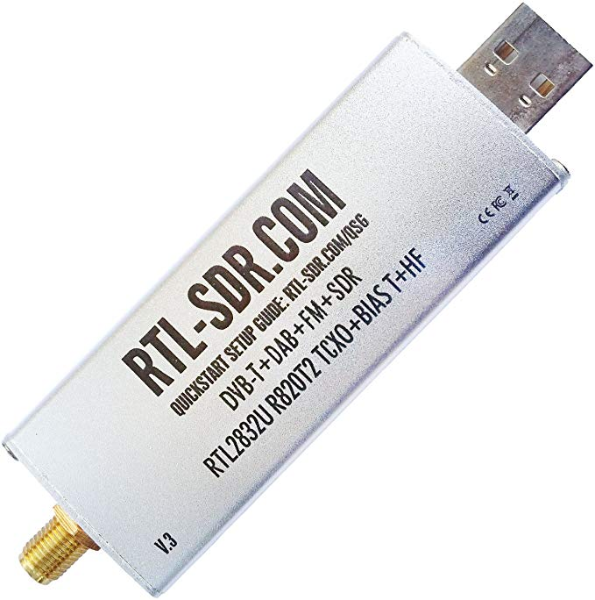
Software Defined Radio
CubicSDR - Software Defined Radio receiver
cutesdr - Simple demodulation and spectrum display program
GQRX - Software defined radio receiver
SDRAngel - SDR player
lysdr - Simple software-defined radio
quisk - Software Defined Radio (SDR)
SoapyAudio - Soapy SDR plugin for Audio devices
SoapyHackRF - SoapySDR HackRF module

Slide 26
Software Defined Radio (cont’d)
SoapyMultiSDR - Multi-device support module for SoapySDR
SoapyNetSDR - Soapy SDR module for NetSDR protocol
SoapyRemote - Use any Soapy SDR remotely
SoapyRTLSDR - Soapy SDR module for RTL SDR USB dongle
SoapySDR - Vendor and platform neutral SDR support library
SoapySDRPlay - Soapy SDR module for SDRPlay
Support for RTL-SDR
Support for SDRPlay SDR
Support for HackRF SDR

Slide 27
APRS Applications
Xastir - APRS GUI client / Digipeater / Igate
YAAC - Yet Another APRS Client
DireWolf - Software "soundcard" AX.25 packet modem/TNC and APRS encoder/decoder
aprsdigi - digipeater for APRS
aprx - APRS Digipeater and iGate
soundmodem - Sound Card Amateur Packet Radio Modems

Slide 28
Logging Applications
TrustedQSL - LotW client
CQRlog - Ham Radio Logging Application
PyQSO - Logging software (written in Python)
klog - The Ham Radio Logging program
tlf - console based ham radio contest logger
tucnak2 - VHF/UHF/SHF Hamradio contest log version 2
twlog - basic logging program for ham radio
wsjtx_to_n3fjp - Logging adapter to allow WSJT-X to log to N3FJP
xlog - GTK+ Logging program for Hamradio Operators

Slide 29
WinLink Applications
Pat WinLink - WinLink for Raspberry Pi (and other platforms)
ARDOP support for Pat WinLink
ARDOP-GUI - Provides graphical representation of ARDOP connections
Find ARDOP - Retrieves local ARDOP sources by KM4ACK
AX25 support for Pat WinLink
PMON - a PACTOR® Monitoring Utility for Linux

Slide 30
Morse Code/CW Applications
aldo - Morse code training program
cw - sound characters as Morse code on the soundcard or console speaker
cwcp - Text based Morse tutor program
xcwcp - Graphical Morse tutor program
cwdaemon - morse daemon for the serial or parallel port
ebook2cw - convert ebooks to Morse MP3s/OGGs
ebook2cwgui - GUI for ebook2cw

Slide 31
Morse Code/CW Applications (cont’d)
morse - training program about morse-code for aspiring radio hams
morse2ascii - tool for decoding the morse codes from a PCM WAV file
morsegen - convert file to ASCII morse code
qrq - High speed Morse telegraphy trainer
twcw - sends morse code via the sound card or serial card (Needs RTC installed)
xdemorse - decode Morse signals to text
rscw - Receive CW through Soundcard

Slide 32
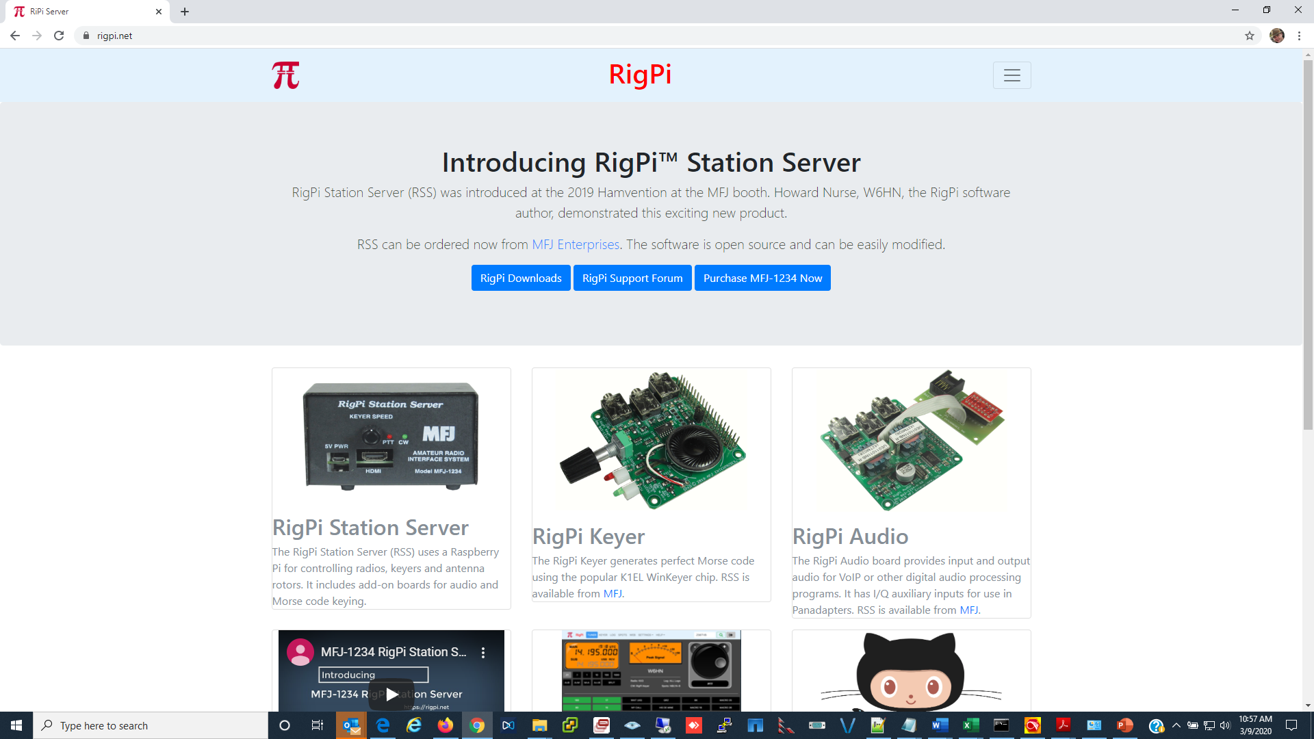

Slide 33
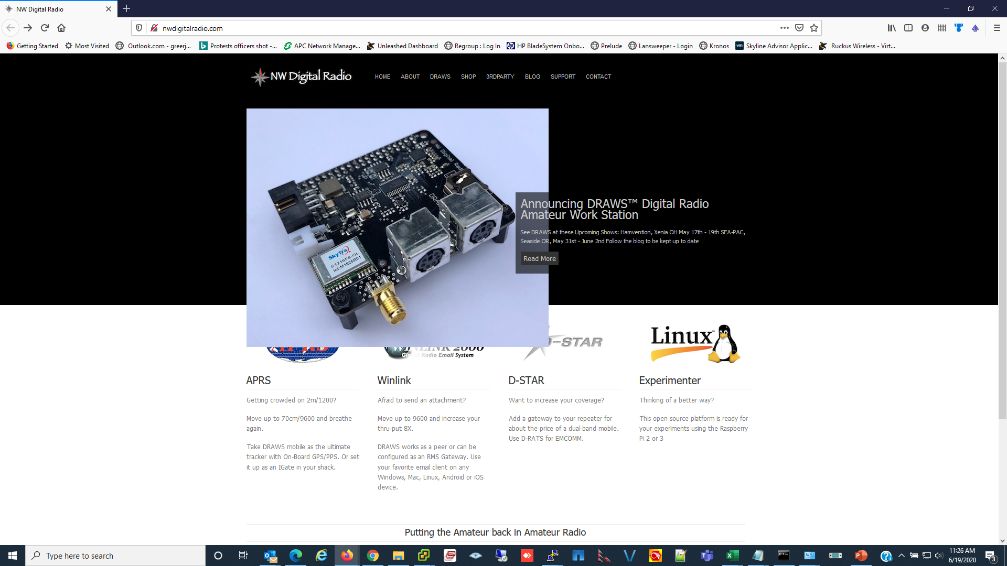

Slide 35
The bottom line
Free software, meet cheap hardware!

