Slide 1
POTA
Parks On The Air

Slide 2
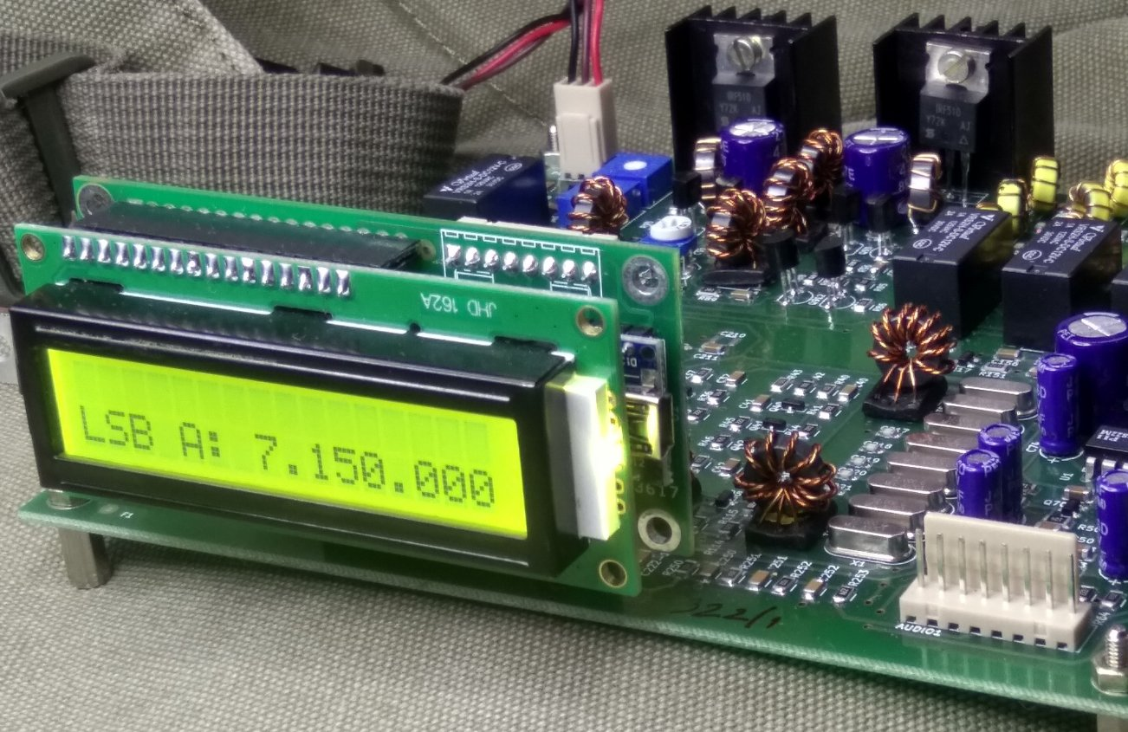
DXPeditions
POTA was started by a team of volunteers after the 2016 program celebrating the
U.S. National park system Centenial came to an end.
By including many of the best aspects of operating a radio in the great outdoors
with a simple set of rules it's quickly become very popular with an ever growing number of hams.

Slide 3
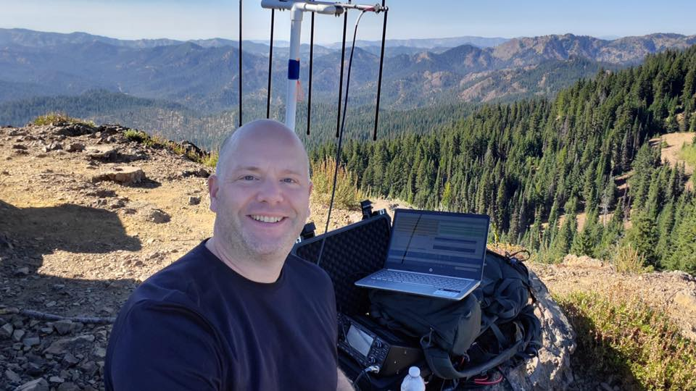
Why would you want to do this?
It’s Fun!
And some things never get old:
“Thanks for the new one!”
“Thanks for activating!”
“Thanks for the park to park!”
Being a POTA activator is like being a DX-pedition - on Field Day – and having it all to yourself!
As a hunter POTA is proof that the bands are not hopeless.
There’s always someone to talk to – and they want to talk to you!

Slide 4
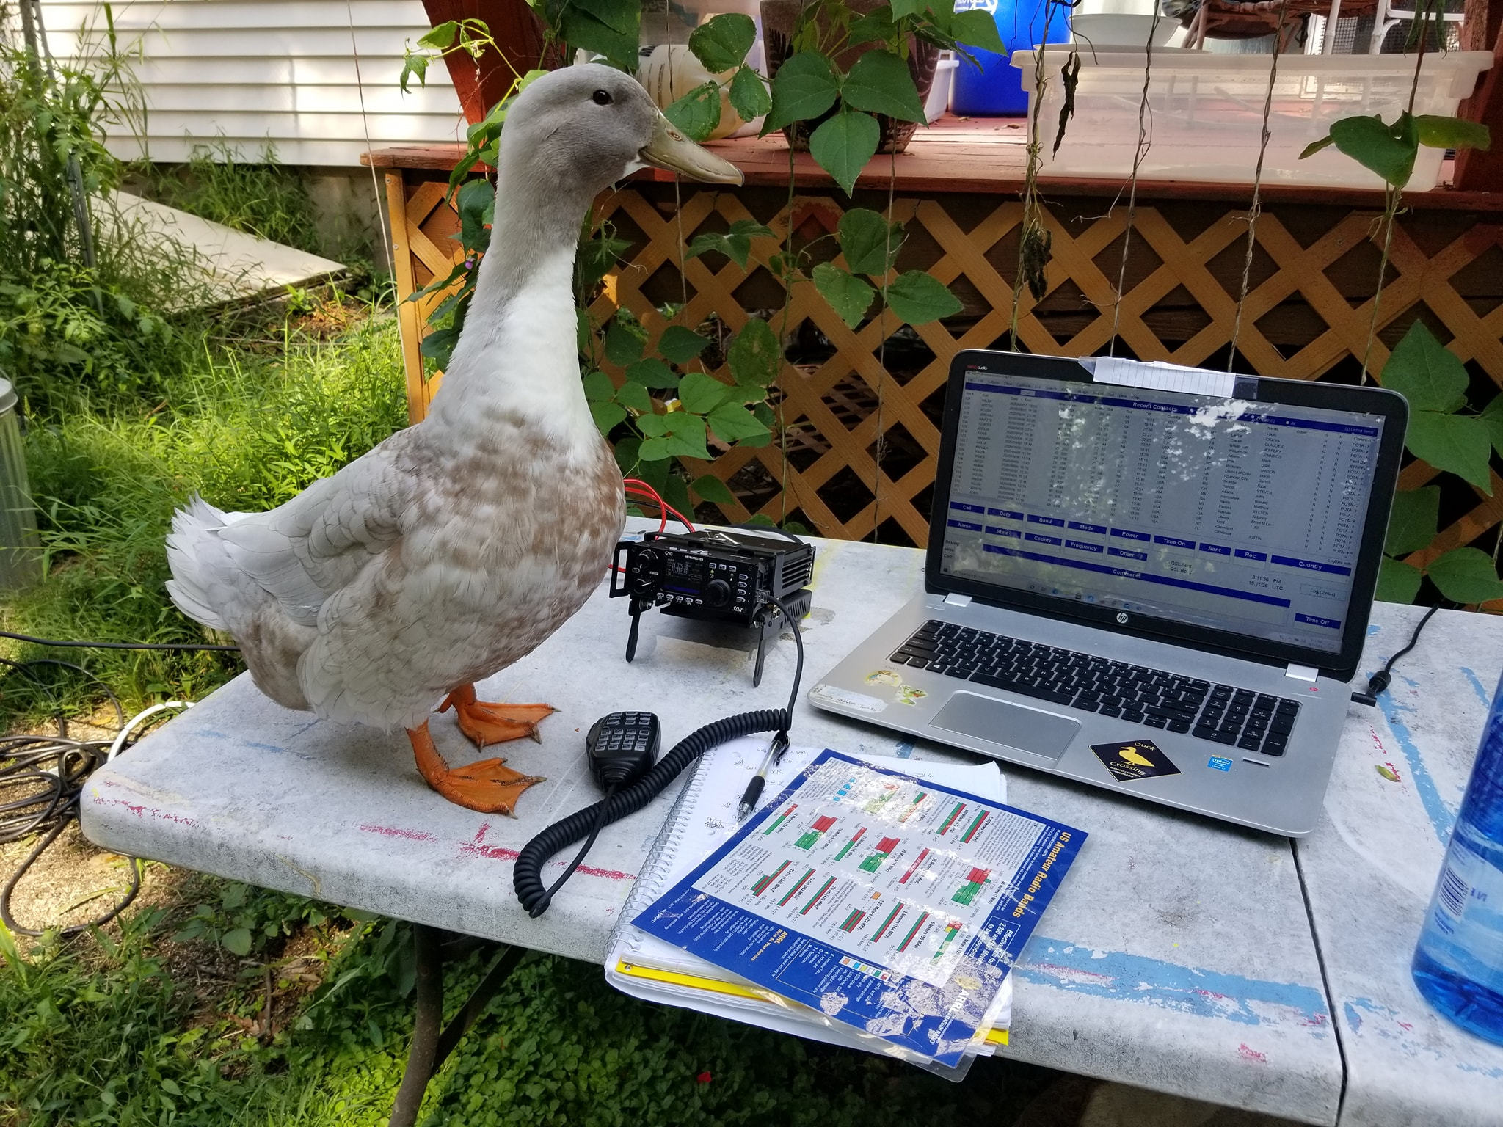
Why would you want to do this?
It’s Easy!
You can hunt from your home shack. Being outside is optional!
You can activate from your car with the mobile you already have

Slide 5
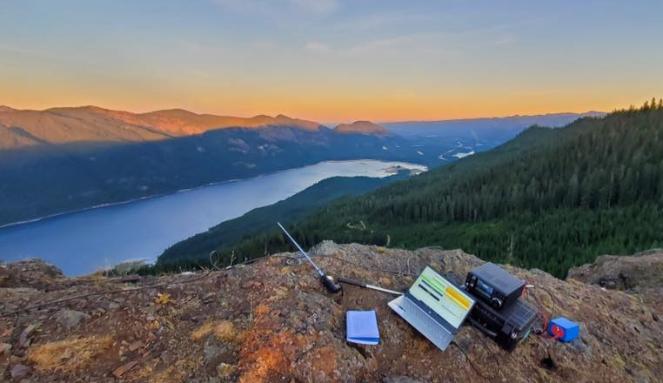
Why would you want to do this?
Conditions are Better!
Usually low noise
Unique challenges
The park is likely more picturesque than your shack wall
A great opportunity to be an ambassador for amateur radio

Slide 6
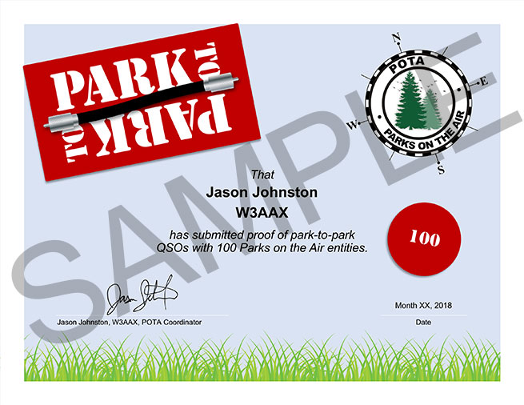
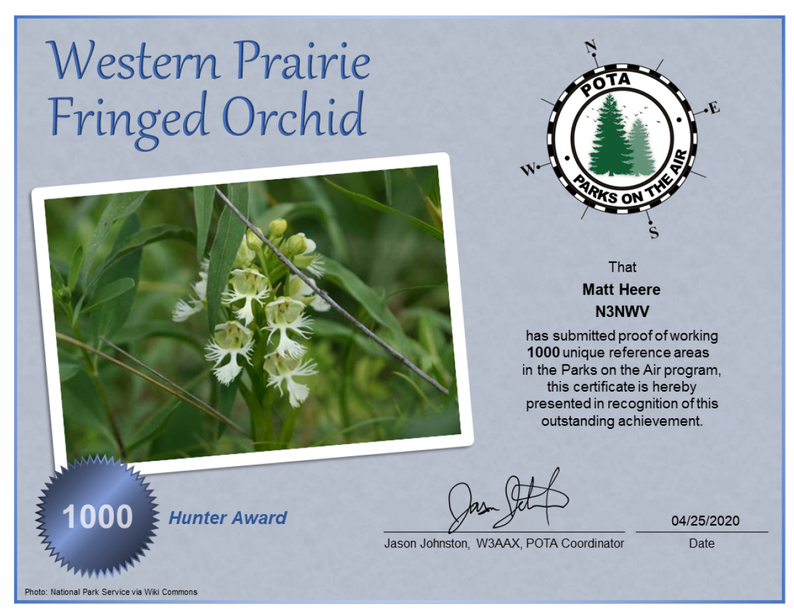
Why would you want to do this?
You Can Earn Awards!

Slide 7
POTA
Is NOT A
Contest!

Slide 8
How Does it Work?
Just ..--- terms you need to know
Activator
Hunter
Running the station in the park
Running a station anywhere

Slide 9
How Does it Work?
Good news: The rules are few and simple!
Follow the law
Follow the DX Code of Conduct
Follow the Golden Rule – Leave no trace
And if you’re an Activator:
You must register at https://pota.app
You and your equipment must be in the park
You need to submit ADIF logs after the activation is over

Slide 10
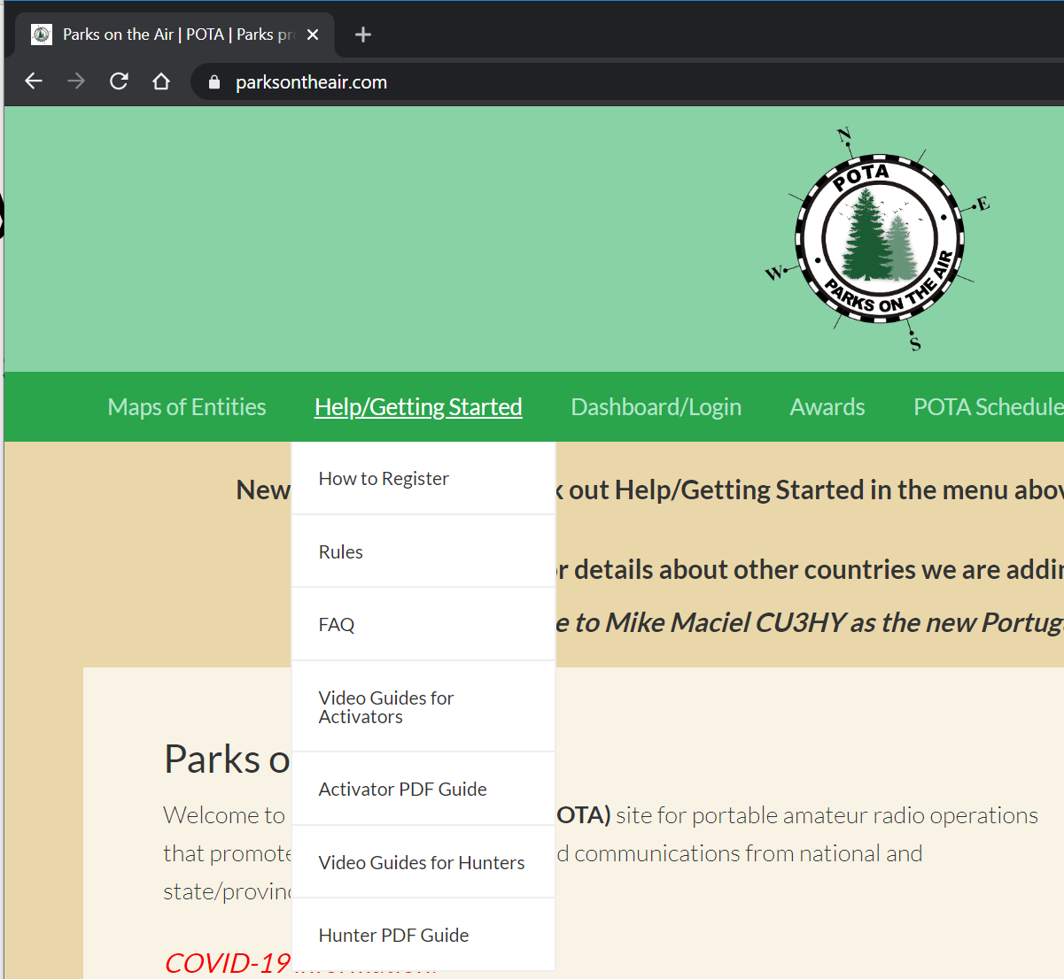
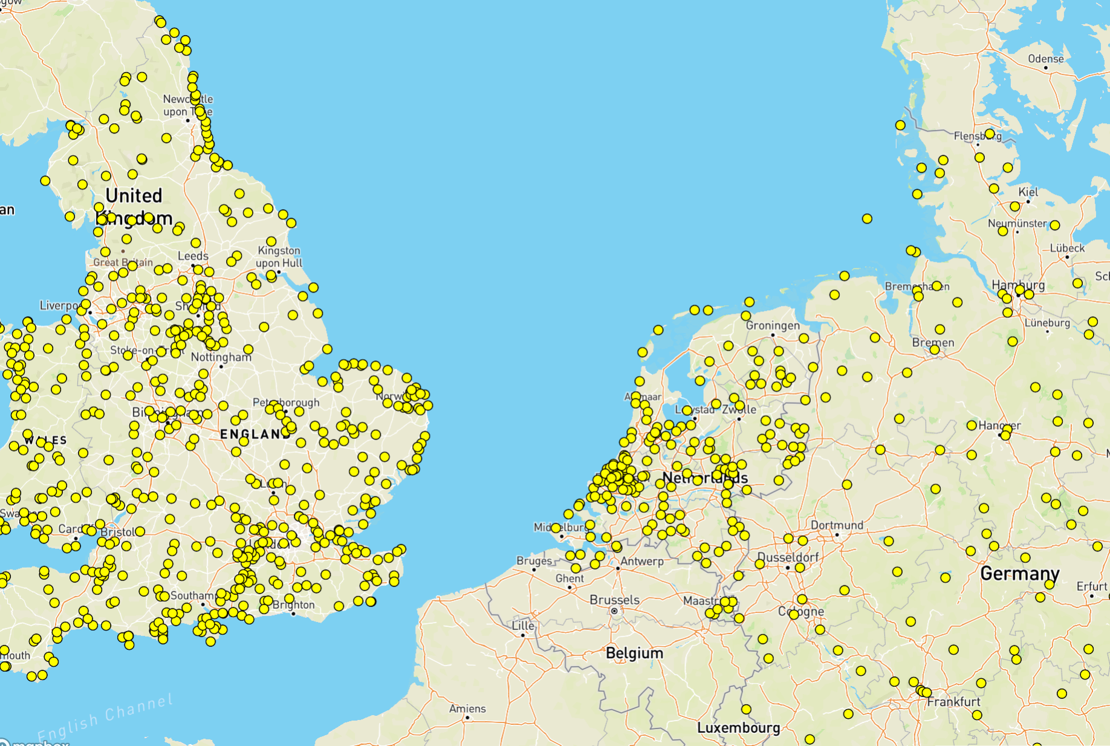
I Already Love It! Where do I go from here?
https://parksontheair.com
https://pota.app

Slide 11
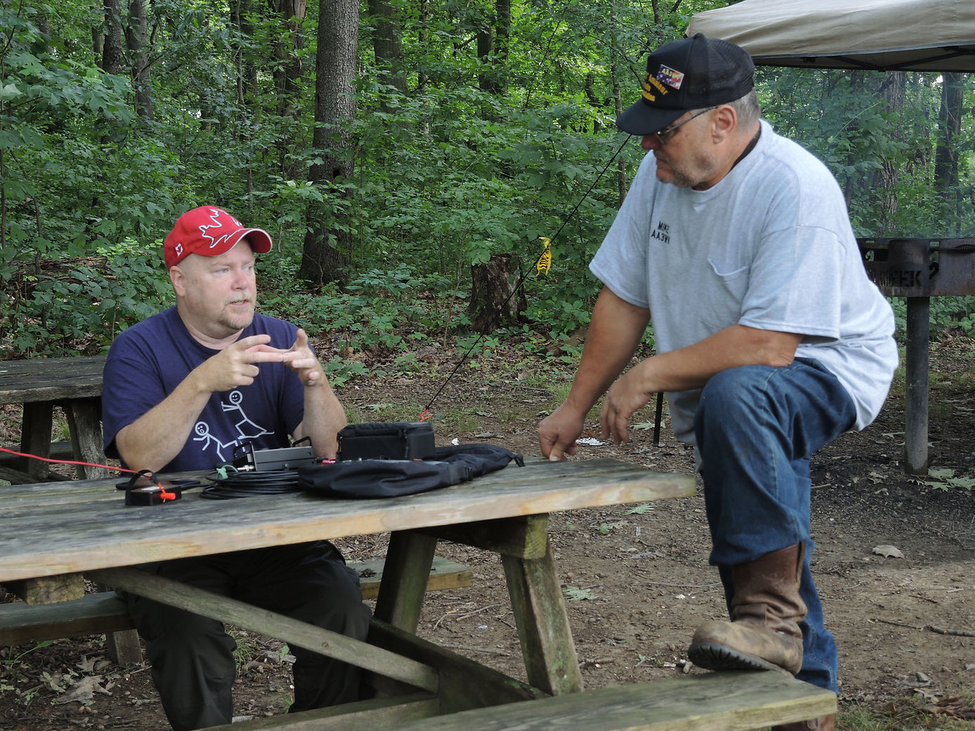
Details for Clubs
Need a club account
Need a couple of club members
Use the club call on the air
Log files contain both the <STATION_CALLSIGN> and <OPERATOR> ADI tags
Both the club and the operator get credit for the QSOs
Dupes are counted based on the club callsign

Slide 12
Last piece of advice: learn this in steps
If you can, visit the place you plan to activate before your actual activation
Setup your kit in the back yard and make sure you have everything (and it works)
Make a checklist based on your test setup so everything gets into the car
Start close to home, when the weather is good, and the activation is all you have planned

